Slide 2
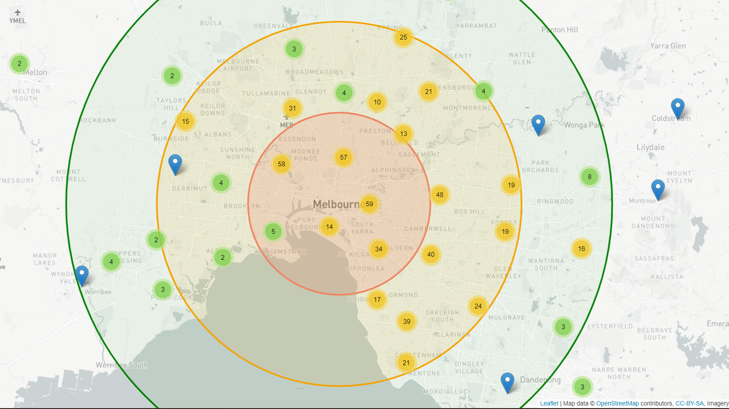
Clustered or Dispersed? Hypothesis: Higher number of sales in locations closer to the city centre

Slide 3
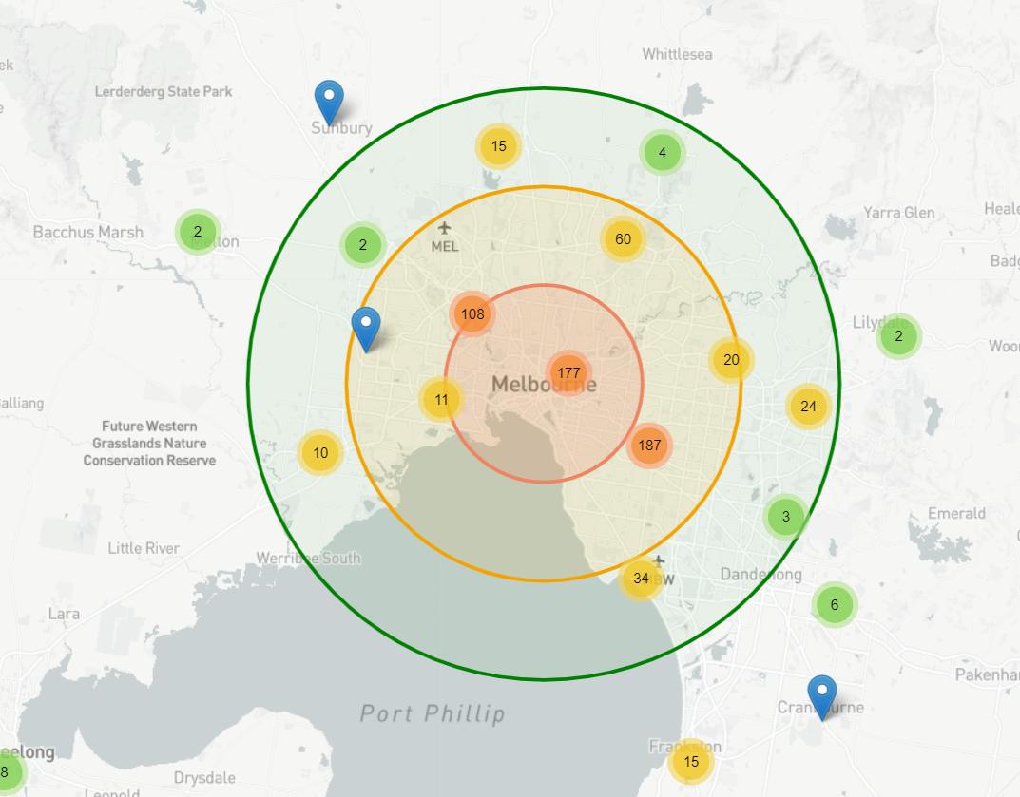
Clustered or Dispersed: Findings
Circa 700 properties sold via auction on the weekend
41% within/close to 10km city-radius
47%% within 10-20km city radius
50% within (north-to-south) eastern regions, 25% in central regions, 25% in western regions.
Findings: The sale of properties via auctions is clustered within 20km city-radius, mainly in the eastern regions.

Slide 4
Data Limitations
Bias in reporting sale price:
Reporting the sale price is not mandated
It is in the agencies best interest to only report favorable prices

